Slide 1

CPU Doctor
Christopher Cohen

Slide 2
WHAT’S TO COME
Who
What
Why
When
Where
Project Sales
Employee Benefits
Questions

Slide 3
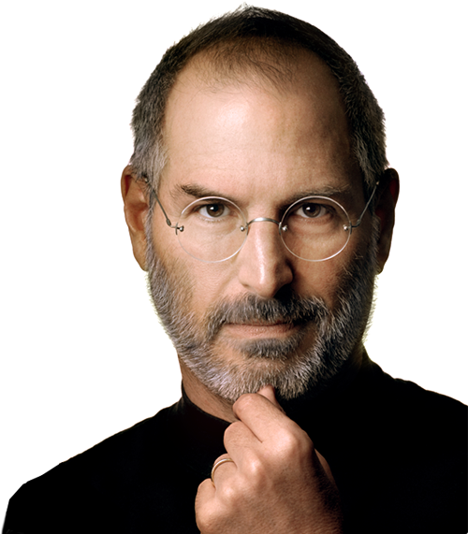
WHO
CPU Doctor is owned and operated by Christopher Cohen. With the help of co-owners, James Astorino and Nick Blardo.

Slide 4

WHAT
We are a small computer sales and repair business. Any issue you have with your technology, we can help. We can help your old computer run faster, whether it just needs a tune-up, or a hardware upgrade. CPU Doctor can also fix smaller devices, broken phone or tablet screens.

Slide 5
WHY
Seeing all the people with broken phone screens around me meant there were many people in need of help. Being a small organization means we can help people one on one with there computer needs.

Slide 6

WHEN
We will be holding our grand opening celebration at 10 a.m. on September 24th.

Slide 7
WHERE
Our location is 123 Main St. Portland, CT. This is our retail store with a center for repairing customers devices.

Slide 8
PROJECTED SALES
We are projecting to do very well on our first month of opening. With sales continuing to do well especially during the holiday season.

Slide 9
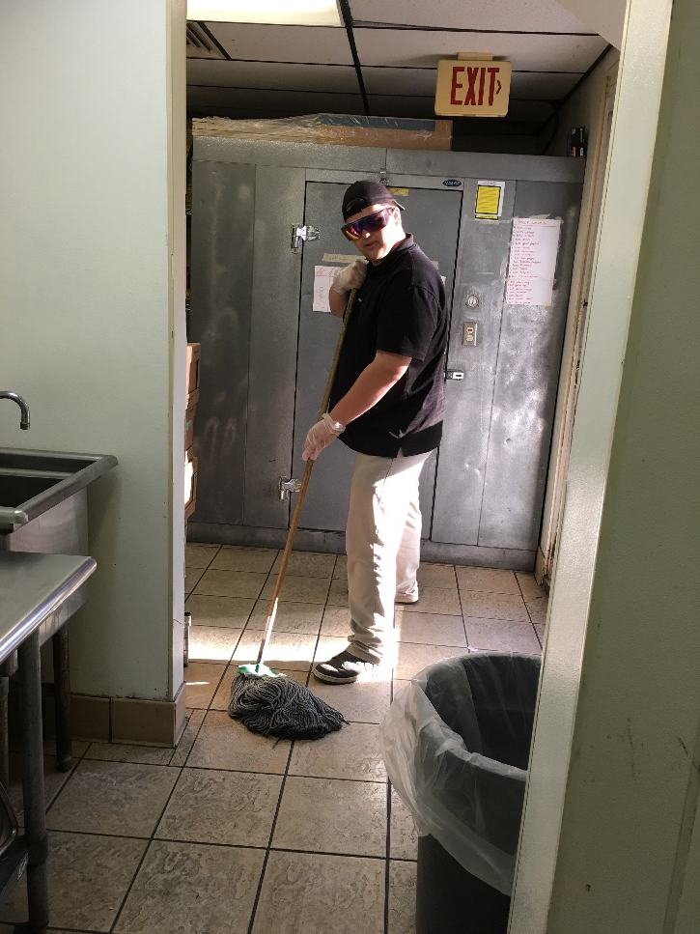
EMPLOYEE BENEFITS
Employees at CPU Doctor are treated with respect and have a starting wage of $10/hr with higher ranked being payed more. We will be hiring part time and full time employees. We will have customer service representatives which will be helping customers navigate the store and selling products. Then we will have repair technicians to fix the computers and mobile devices that come into the store.

Slide 10
THANK YOU
If you have an questions, now will be the time to ask. I thank you for your time and full attention.

